Slide 1
Winners and Losers?
The Effect of Gaining and Losing Access to Selective Colleges on Education and Labor Market Outcomes
Sandra E. Black, Jeffrey Denning, Jesse Rothstein

Slide 2
Question
What is the effect of attending a more selective school?
Why is this hard to estimate?
Specific question: How did the Texas Top Ten Percent Rule affect student enrollment, graduation, and earnings.

Slide 3
Texas Top 10 Percent Rule
In 1996 the 5th Circuit ruled in Hopwood v. Texas that schools could not use race in admission to college.
In response, Texas passed a law that came to be known as the Top 10 percent policy
This stated that if you were in the top 10 percent of your public Texas high school you were automatically admitted to any Texas public university

Slide 4
How would you evaluate this?

Slide 5
How would you evaluate this?
The most obvious would be a regression discontinuity
Suppose you don’t have class rank (this was not collected prior to the policy--still isn't actually)
Difference in Difference
Suppose you don’t have an indicator for being in the top 10 percent of your class in the pre period (this is true)

Slide 6
Implications
Some students got access to UT Austin that wouldn’t have previously
Others who were going to UT Austin got pushed out.

Slide 7
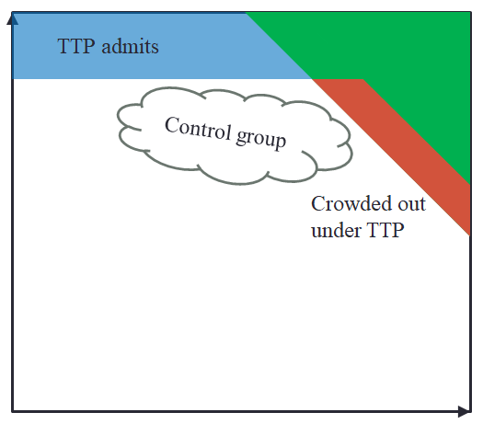
What Happened
Class Rank
Fraction of Students attending UT Austin

Slide 8
So what to do?
Despite being a very influential policy, there haven’t been evaluations using statewide data due to the lack of data on student class rank
However, if you could predict top 10 percent status that could be used...How?

Slide 9
Predict Top 10 Status
We have top 10 indicators for students applying to college in the post period.
We also have test scores, class taken, absences, school info, student demographics
We use these predict top 10 percent

Slide 10
Methods of Prediction
Random Forest
Designed to address overfitting
Logit
Super easy
These two end up being very high correlated
We extend our predictions “out of sample” which means before the implementation of the T10 policy

Slide 11
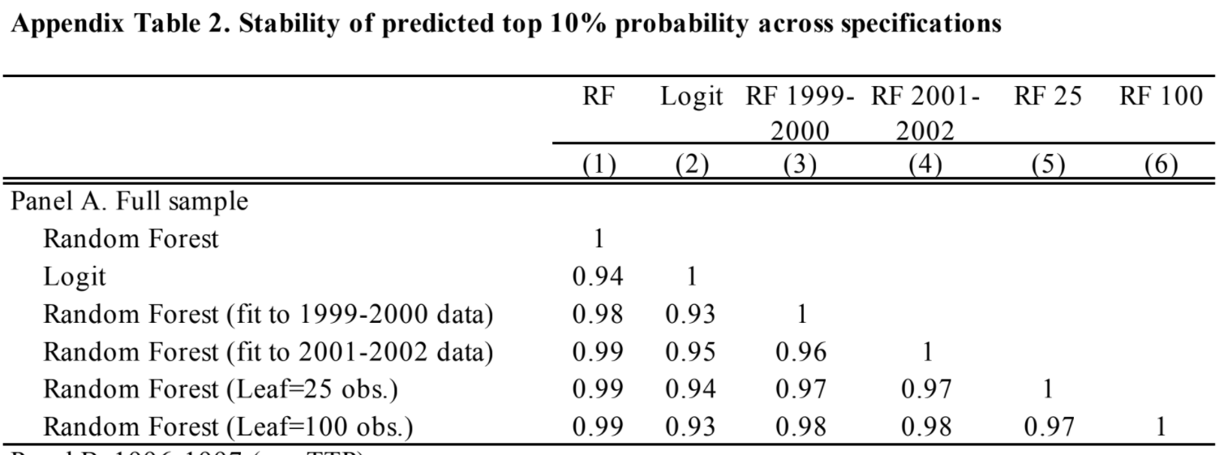
I told you they were highly correlated

Slide 12
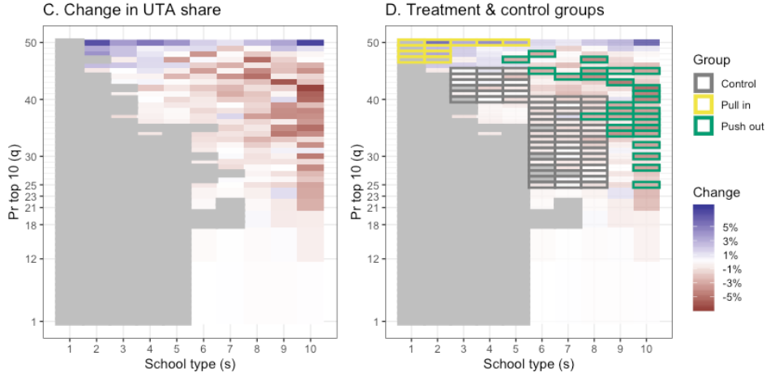
Empirical Change in Enrollment

Slide 13
Next Step
Pick affected groups
Our baseline was just to use a simple (ad hoc) choice/heuristic.
(>2.5 pp change or >1.8 and in between cells with >3 pp)
We also use a LASSO
LASSO picks which things should be included--which are non zero

Slide 14
LASSO
Penalizes adding more cells--avoids overfitting
We modify a LASSO slightly to get contiguous cells

Slide 15
Machine Learning Pause
Why did we do all of that?

Slide 16
Machine Learning Pause
Why did we do all of that?
We didn’t know treatment--we had to predict it
We used our knowledge about the world to get at treatment
Now what?
Differences in Differences!

Slide 17
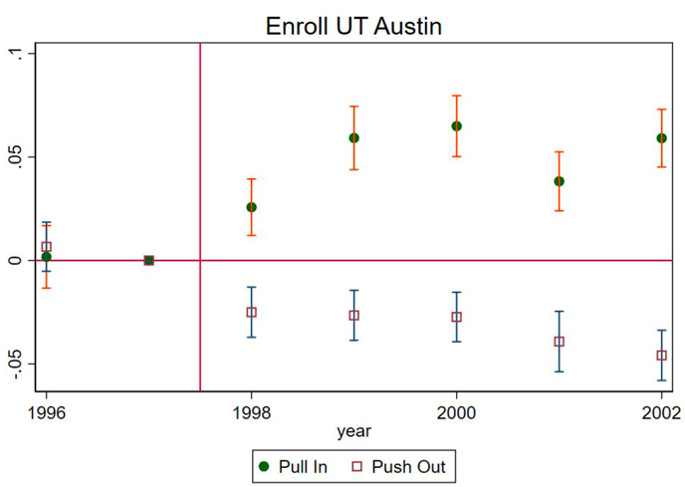
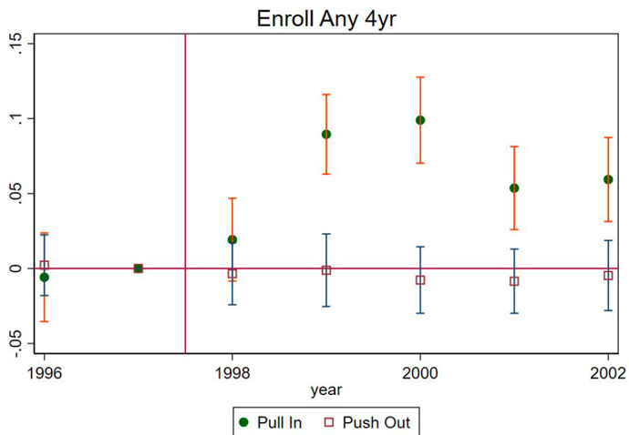
Outcomes

Slide 18
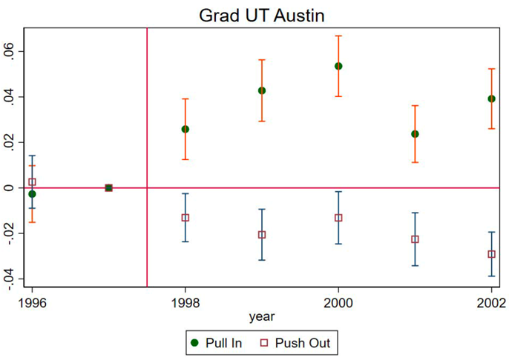
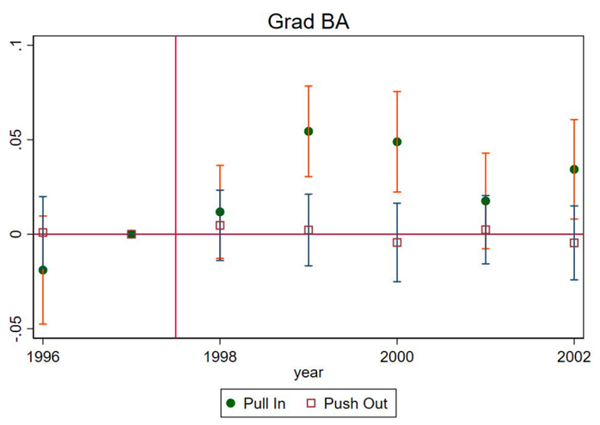
Outcomes

Slide 19
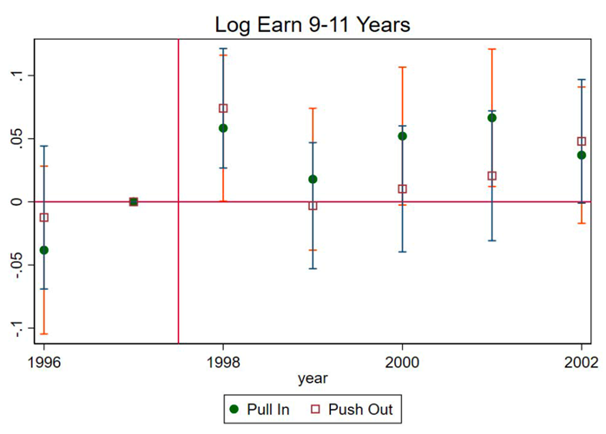
Outcomes

Slide 20
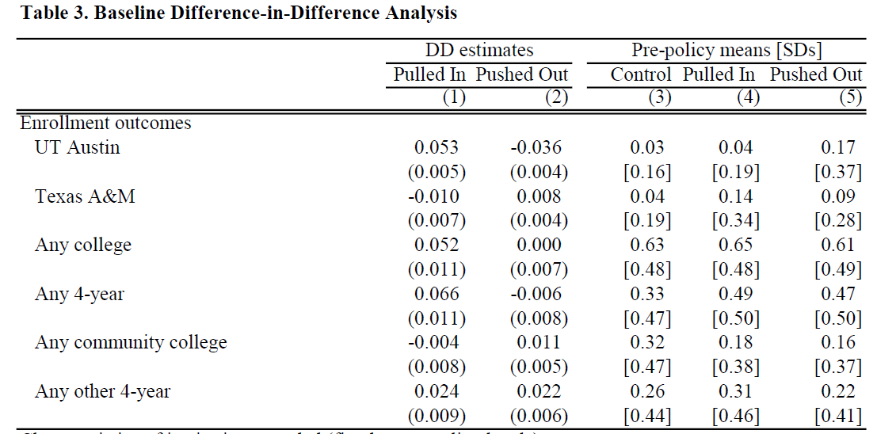
Outcomes

Slide 21
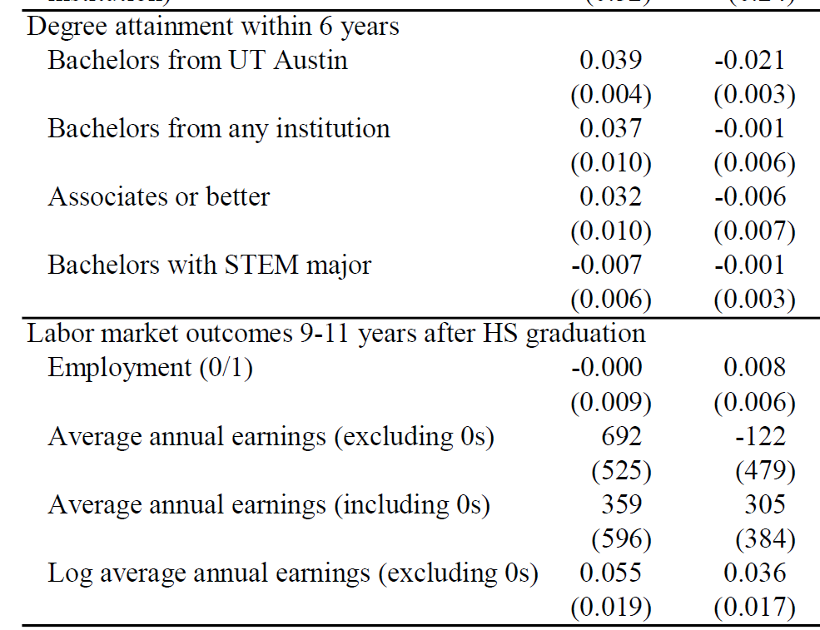
More Outcomes

Slide 22
Conclusion
Machine learning and causal inference can be complementary
Often prediction is useful for determining treatment

